Slide 1
The volatility surface a practitioner’s tools
Bruno Dupire
Head of Quantitative Research
Bloomberg LP

Slide 2
What is needed
The Surface
Visualization
Missing data
Elections

Slide 3
The surface

Slide 4
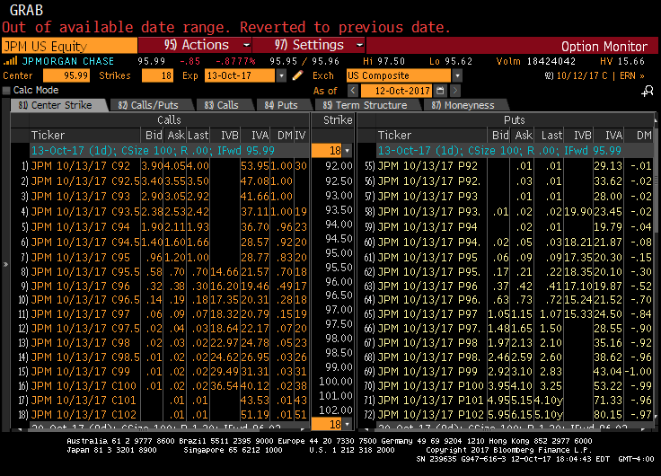
Option market prices

Slide 5
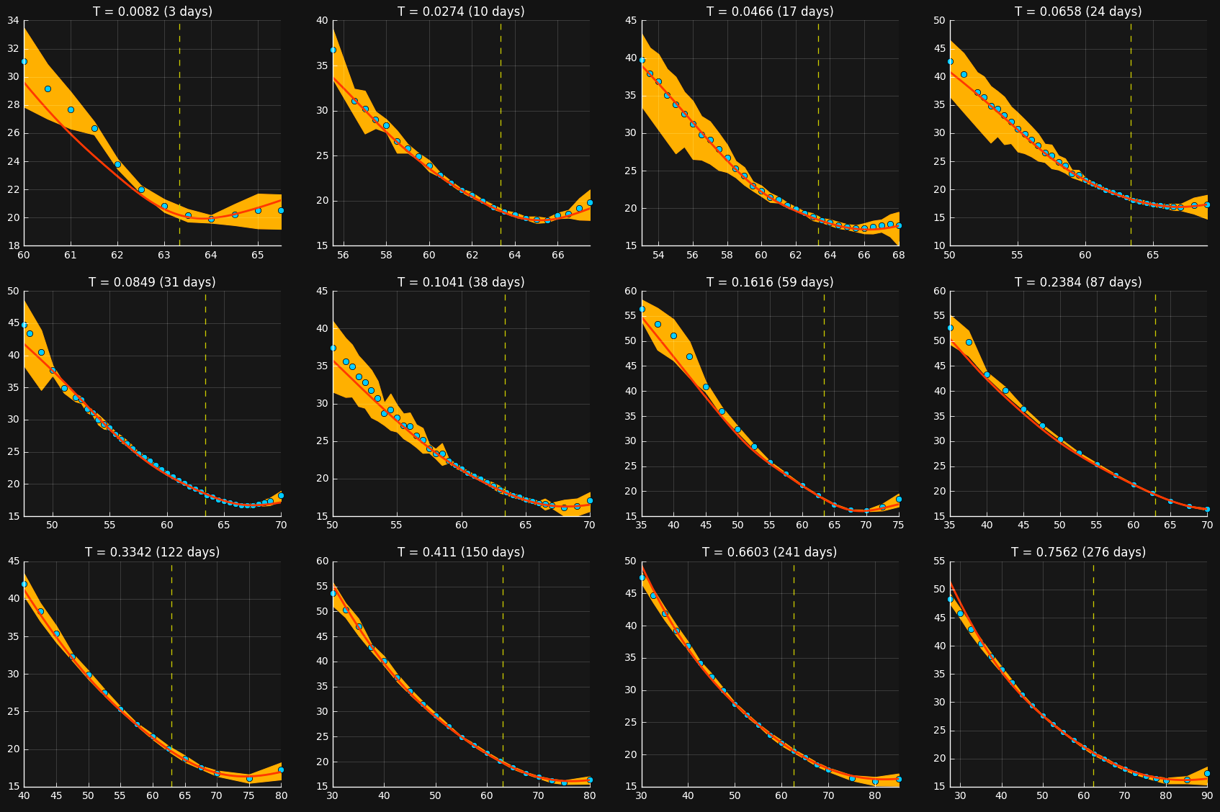
SKews

Slide 6
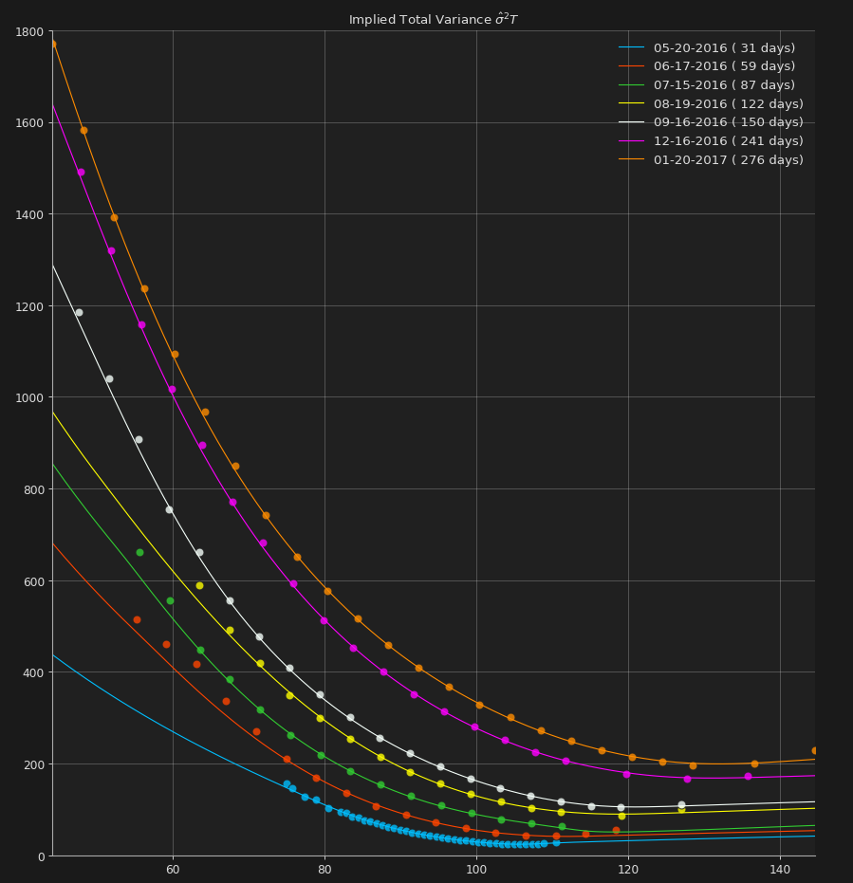
Cumulative variance

Slide 7
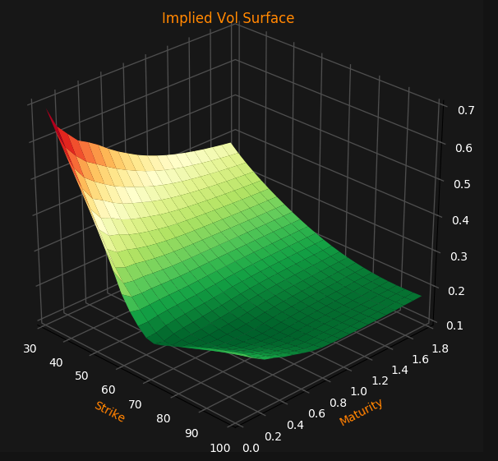
Central object: Implied Vol Surface

Slide 8
Tail behavior

Slide 9
Not too fast
Volatility extrapolation requires attention
$K_{1}<K_{2} ⇒C_{K_{2}}\left(\hat{σ_{k_{2}}}\right)≤C_{K_{1}}\left(\hat{σ_{k_{1}}}\right)⇒ \hat{σ}$ cannot increase too fast
Roger Lee’s Moment Formula:
$\lim_{K ∞}{\sup{\frac{T \hat{σ^{2}(K)}}{ln⁡(K)}=β∈\left[1, 2\right] with \frac{1}{2 β}+\frac{β}{8} −\frac{1}{2}=sup⁡\{p:ES_{T}^{1+p}<∞\}}}$
$β=0 ⇔$ every moment of S is finite

Slide 10
… but Fast enough
Frequently implied vols converge to a finite limit for far OTM strikes due to
Choice of parametric extrapolation
Quotes in delta space for FX
RN density as mix of LogNormals
Problematic because of
Thin tails
Dynamics

Slide 11
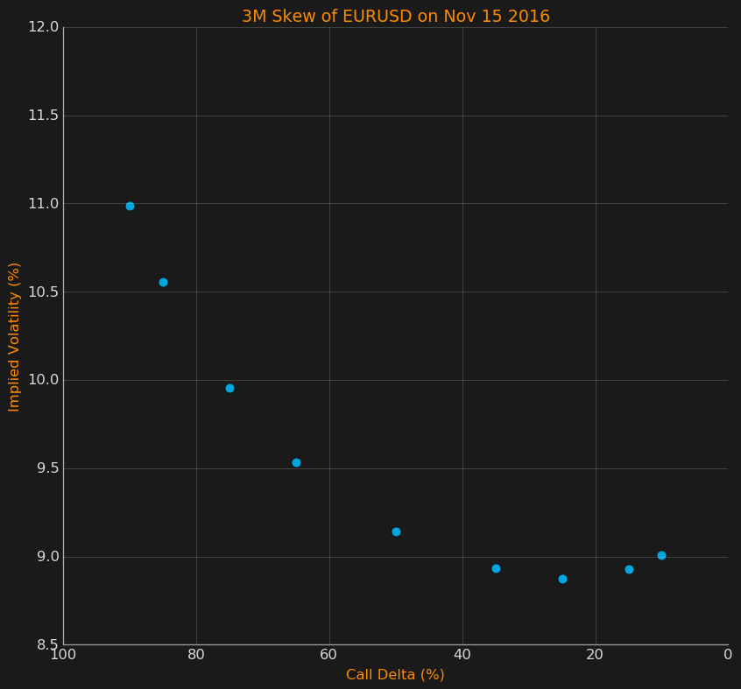
FX options are quoted in Delta

Slide 12
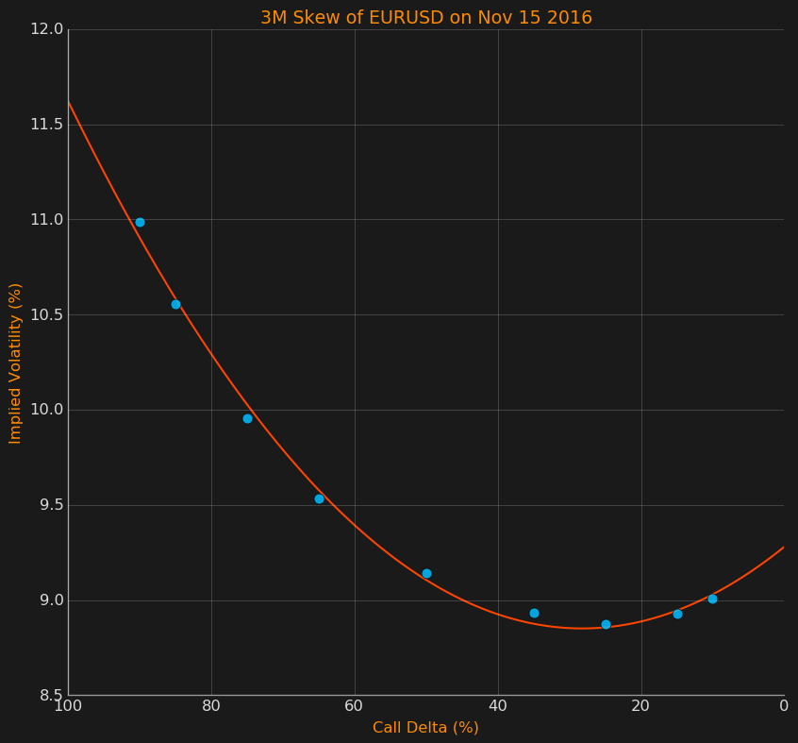
FX options are quoted in Delta

Slide 13
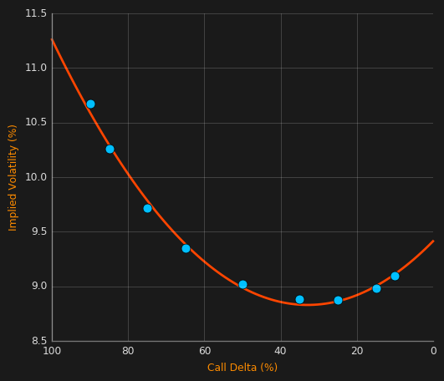
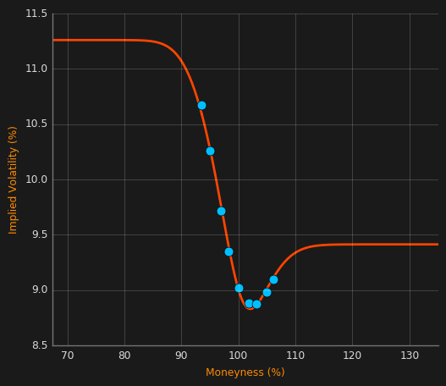
Flat far otm volatility
3M Skew of EURUSD on Nov 11 2016

Slide 14
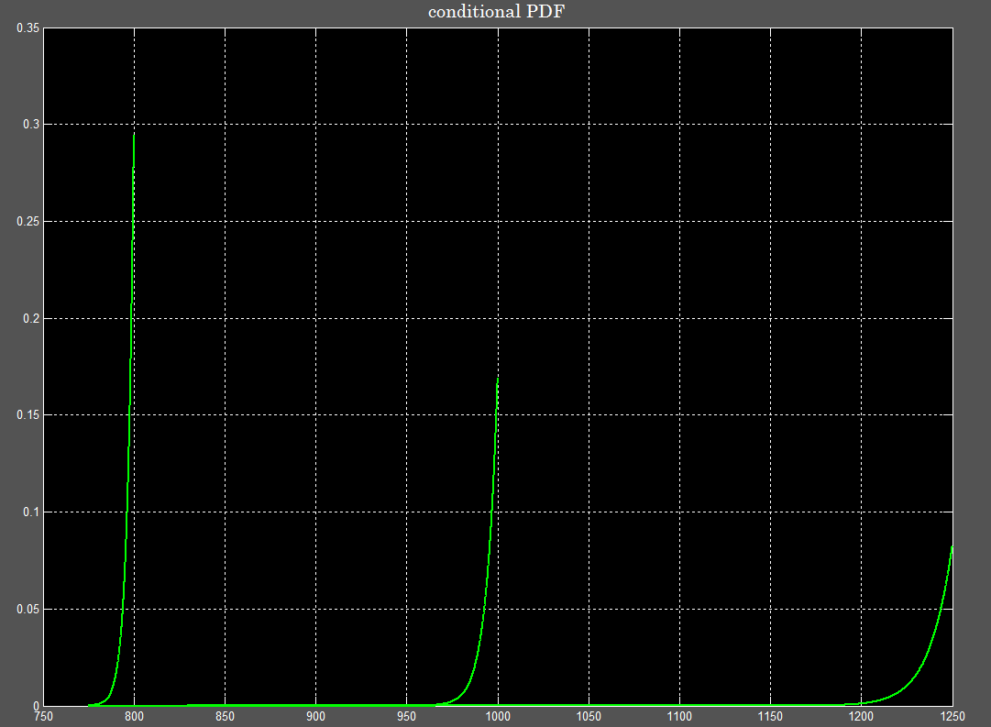
Conditional behavior

Slide 15
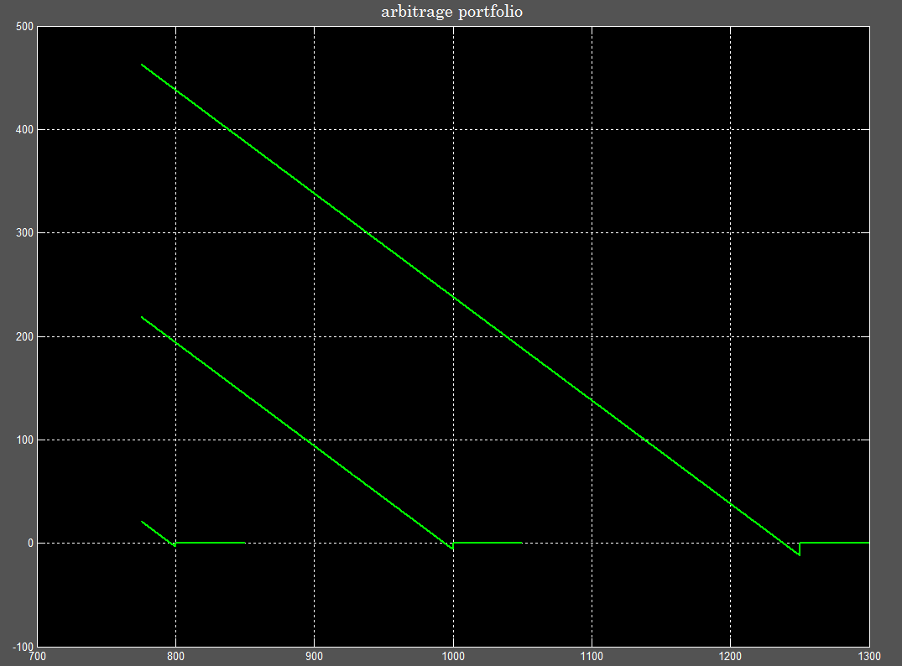
“Arbitrage” Portfolio

Slide 16
Deep otm implied variance can never rise

Slide 17
long term rate can never fall
Dybvig, Ingersoll and Ross (1996): In an arbitrage-free world without transaction costs, Long Forward and Zero Rates can never fall!
Long Zero-Coupon rate at time $t$
$z_{L}(t)=\lim_{\left\{T→ +∞\right\}}{z(t, T)}$ (if it exists)
Illustrative Example: The Perpetual Bond
Today’s yield curve is flat at $r_{0}$
Infinite stream of zero-coupon bonds with face value $\frac{\exp\left(r_{0}T\right)}{T(T+1)}$

Slide 18
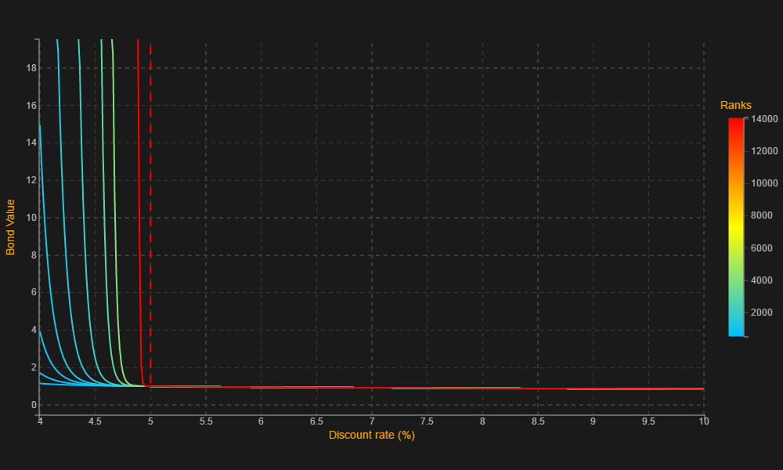
Perpetual bond
Value today:
$V_{0}\left(r_{0}\right)=\sum_{T=1}^{+∞}{\frac{1}{T(T+1)}=1}$
Value tomorrow:
$V_{δt}\left(r_{δt}\right)=exp⁡(r_{δt}δt)\sum_{T=1}^{+∞}{\frac{exp⁡({(r}_{0}−r_{δt})T)}{T(T+1)}}$
$+∞$ if $r_{δt}<r_{0}$
Finite if $r_{δt}≥r_{0}$
Arbitrage-Free assumption:
$$P[r_{δt}<r_{0}]=0$$

Slide 19
What about long term Variance swap?
If the instantaneous variance $v_{t}$ is a martingale.
$$\frac{dS_{t}}{S_{t}}=\sqrt{v_{t}} dW_{t} \\ \frac{dv_{t}}{v_{t}}=α dZ_{t}$$
Then the Variance Swap Term Structure at $t$:
$${VS}_{t,T}^{2}={\frac{1}{T−t}E}_{t}\left[\int_{t}^{T}{v_{u}du}\right]=v_{t}$$
Independent of T → Flat! No constraint on its evolution.
For instance,

Slide 20
What about long term Variance swap?
If the instantaneous variance $v_{t}$ is a martingale.
$$\frac{dS_{t}}{S_{t}}=\sqrt{v_{t}} dW_{t} \\ \frac{dv_{t}}{v_{t}}=α dZ_{t}$$
Then the Variance Swap Term Structure at $t$:
$${VS}_{t,T}^{2}={\frac{1}{T−t}E}_{t}\left[\int_{t}^{T}{v_{u}du}\right]=v_{t}$$
Independent of T → Flat! No constraint on its evolution.
For instance,

Slide 21
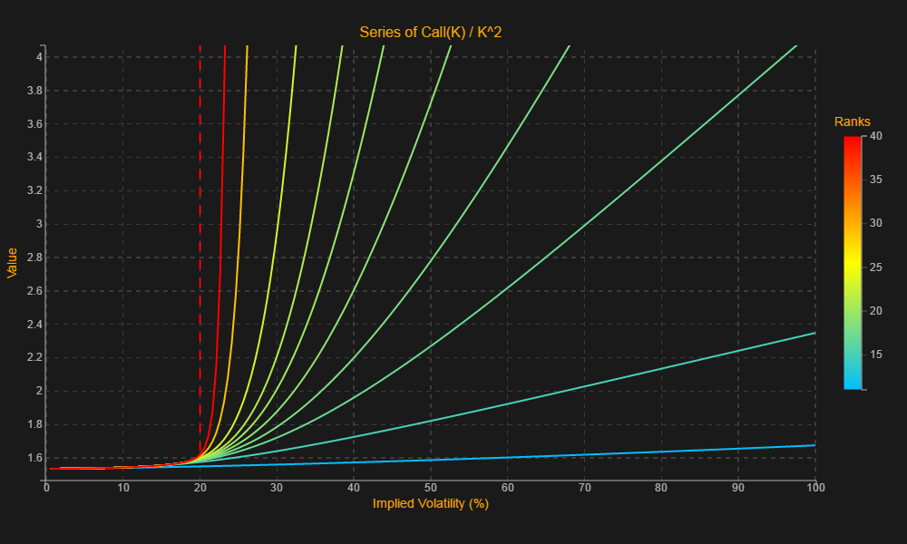
Far otm implied variance can never rise
For fixed T, Implied Variance at $t$: $IV_{t} ≡σ_{t}^{2}\left(T−t\right)$
Considering a Portfolio of $\frac{1}{K^{2}}\frac{1}{C_{K,T}(σ_{0})}$ Calls(K)
Value today:
$V_{0}\left(σ_{0}\right)=\sum_{K=1}^{+∞}{\frac{1}{K^{2}}}$
Value tomorrow:
$V_{δt}\left(σ_{δt}\right)=\sum_{K=1}^{+∞}{\frac{1}{K^{2}}\frac{C_{K, T−δt}(σ_{δt})}{C_{K, T}(σ_{0}) }}$
$+∞$ if${IV}_{δt}>IV_{0}$
Finite if${ IV}_{δt} ≤IV_{0}$
→ $P\left[{IV}_{δt}>IV_{0}\right]=0$

Slide 22
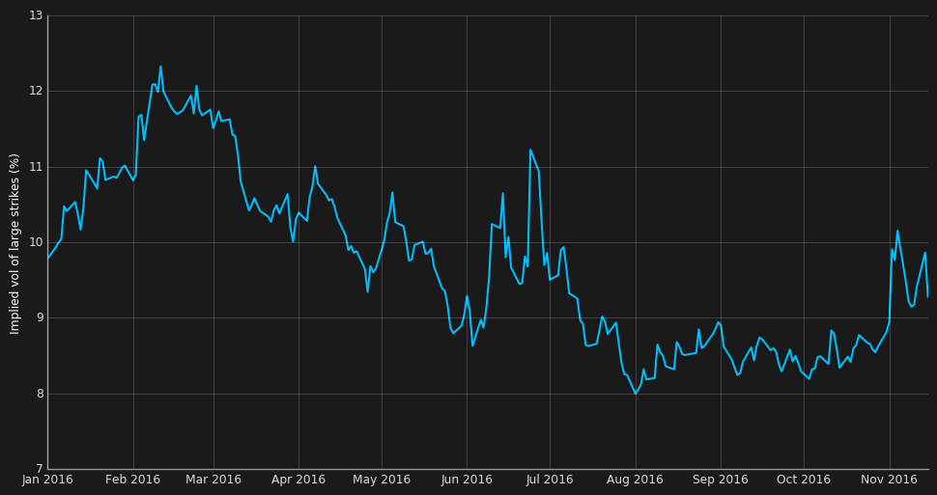
High Strike volatility through time

Slide 23
summary
Long Term rate can never fall.
Long Term VS can fall or rise.
Deep OTM implied variance can never rise.

Slide 24
Implied vol extrapolation
In summary
Do not extrapolate flatly
Do not extrapolate linearly
Instead,
Extrapolate implied variance expressed in log moneyness (e.g. hyperbolic SVI)
Fit to CDS (lump mass at 0) imposes the slope at 0

Slide 25
earnings

Slide 26
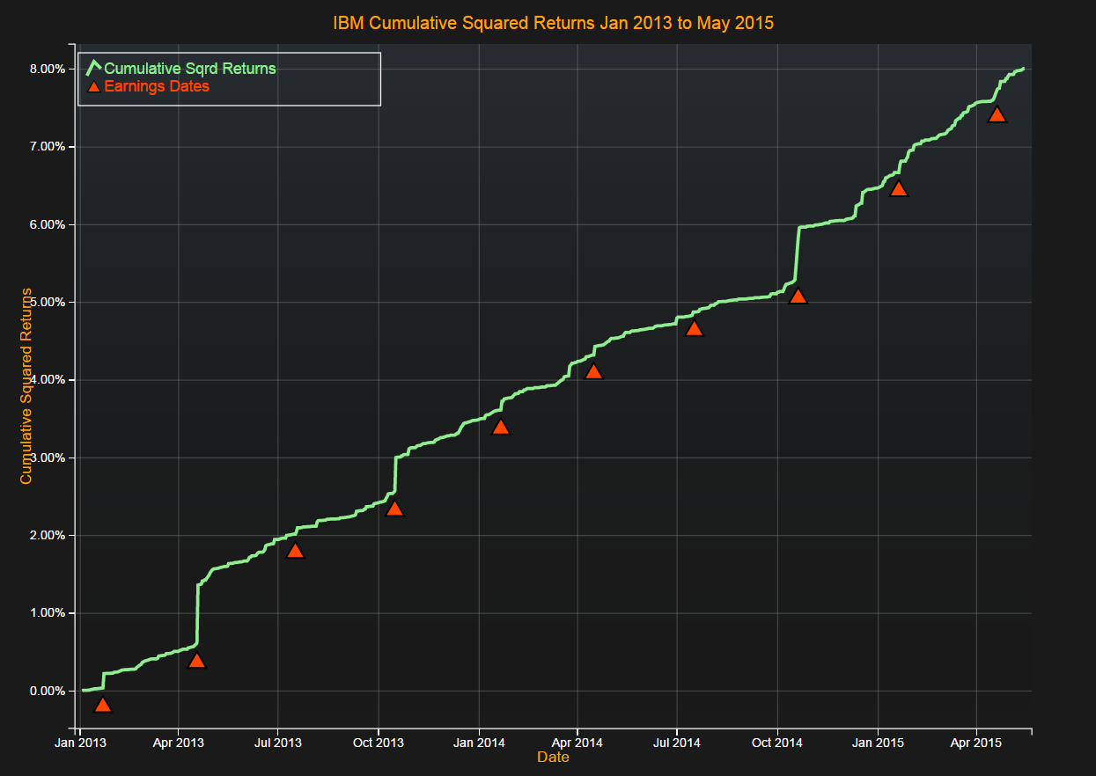
Earnings and Historical Volatility
IBM often has more uncertainty on the day of an Earnings Announcement than the rest of the quarter

Slide 27
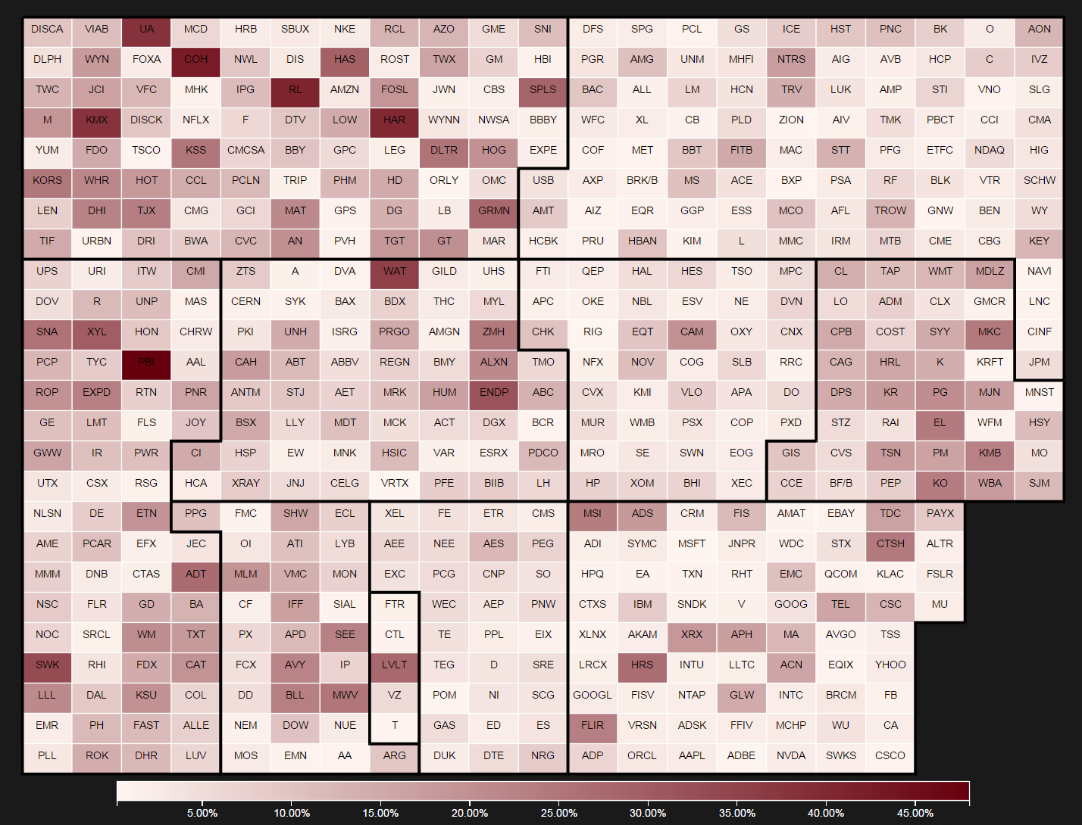
Earnings and Historical Volatility
S&P 500: Percentage of Variance on Earnings Dates. Jan 13 – May 15
Up to 48% of Variance is accounted for by just 10 of 600 days.

Slide 28
Earnings and Historical Volatility
Sectors like Consumer Discretionary, Consumer Staples and Industrials have more Variance on Earnings Dates than Financials

Slide 29
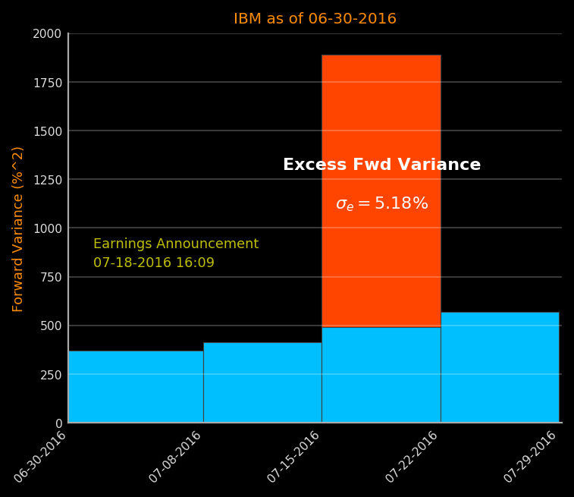
Forward variance
IBM often has more uncertainty on the day of an Earnings Announcement than the rest of the quarter

Slide 30
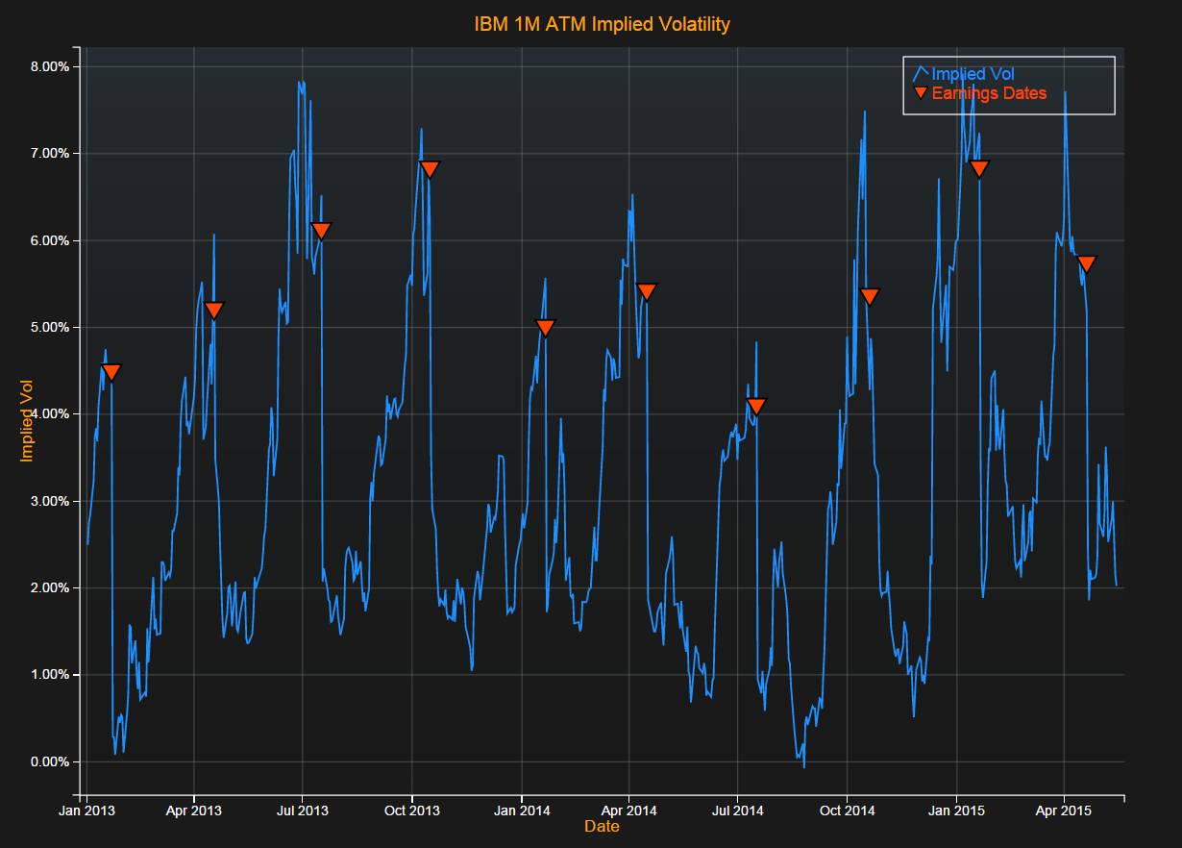
Earnings and Implied Volatility
IBM 1M ATM Implied Volatility from Jan 2013 to May 2015
Implied Volatility exhibits significant drop on Earnings Dates

Slide 31
visualization

Slide 32
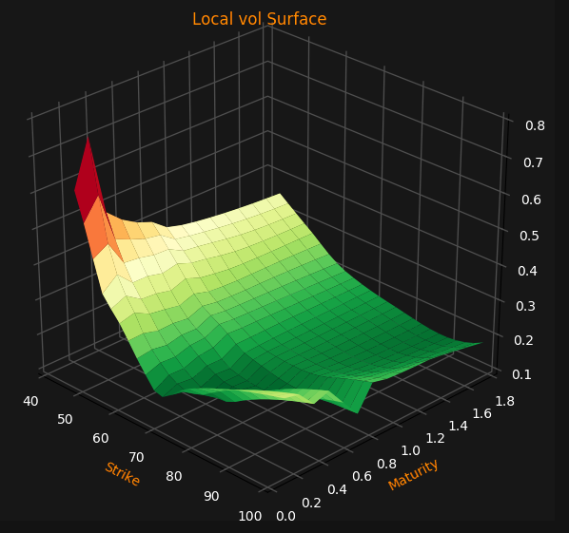
Implied Vol and Local Vol Surfaces

Slide 33
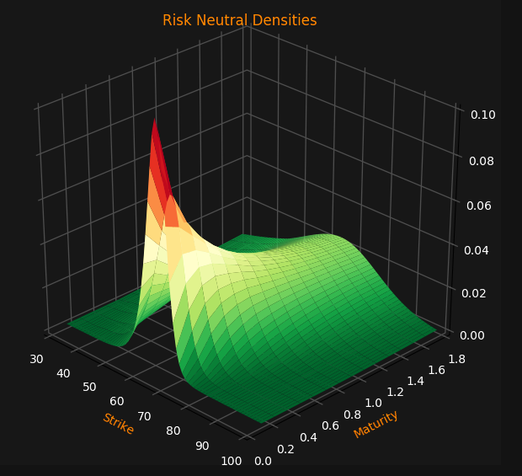
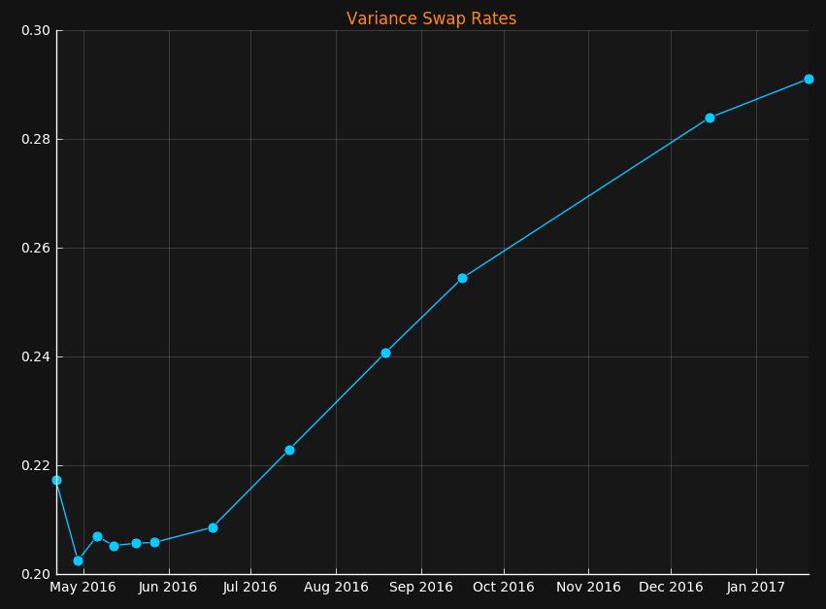
RN density and fwd variance

Slide 34
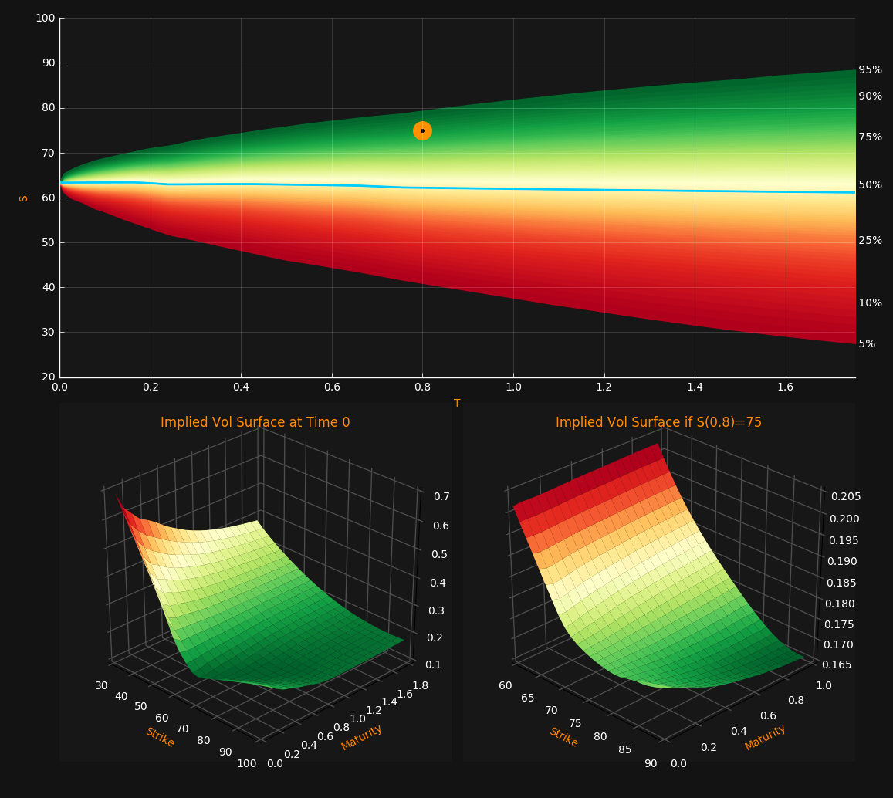
Conditional Vol Surface

Slide 35
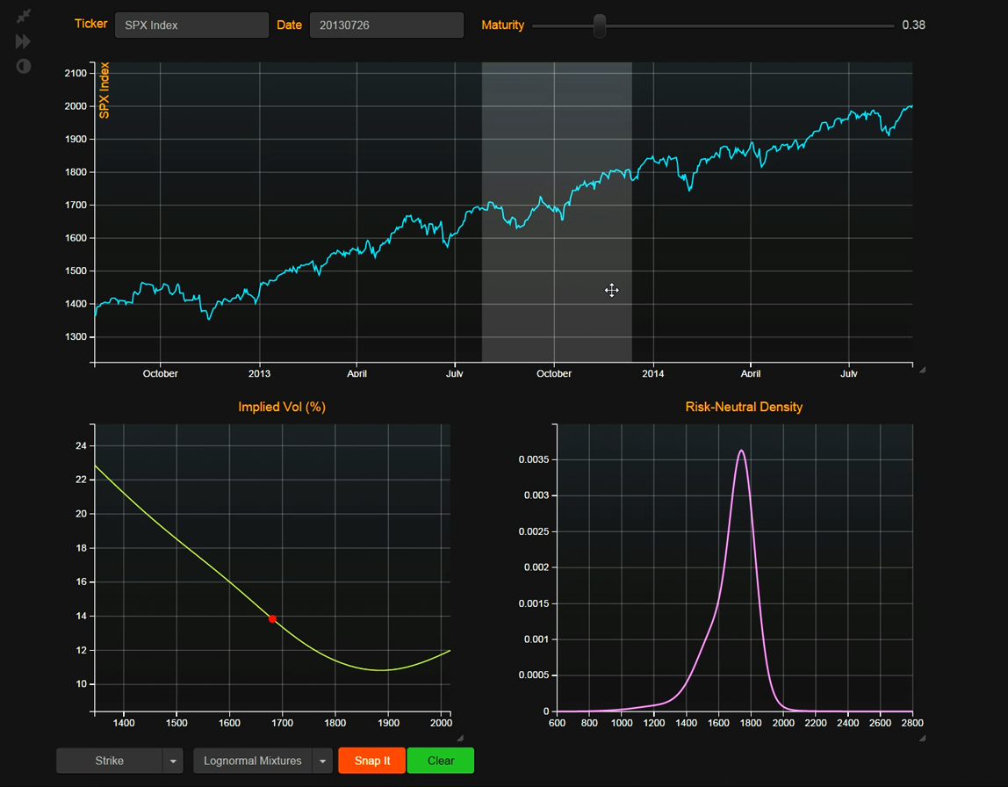
Skew and Density

Slide 36
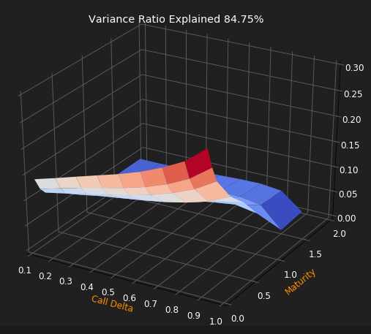
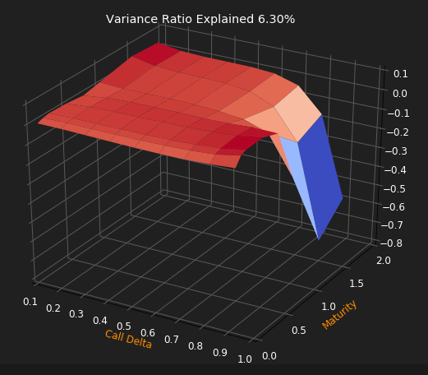
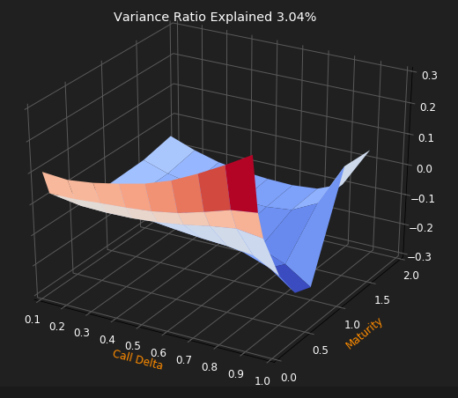
ImplIed Vol Surface PCA
DJX Index, 01/01/2015 – 12/31/2015, daily changes
Deltas: 10, 20, 30, 40, 50, 60, 70, 80, 90
Maturities: 1M, 2M, 3M, 6M, 9M, 1Y,1.5Y, 2Y

Slide 37
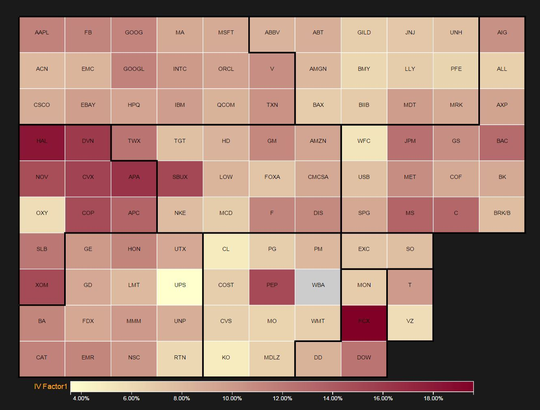
S&P 100 July 2014 - Feb 2015
3M ATM Imp. Vol. PCA Factor 1. Variance explained: 56%

Slide 38
Option volume

Slide 39
Open interest

Slide 40
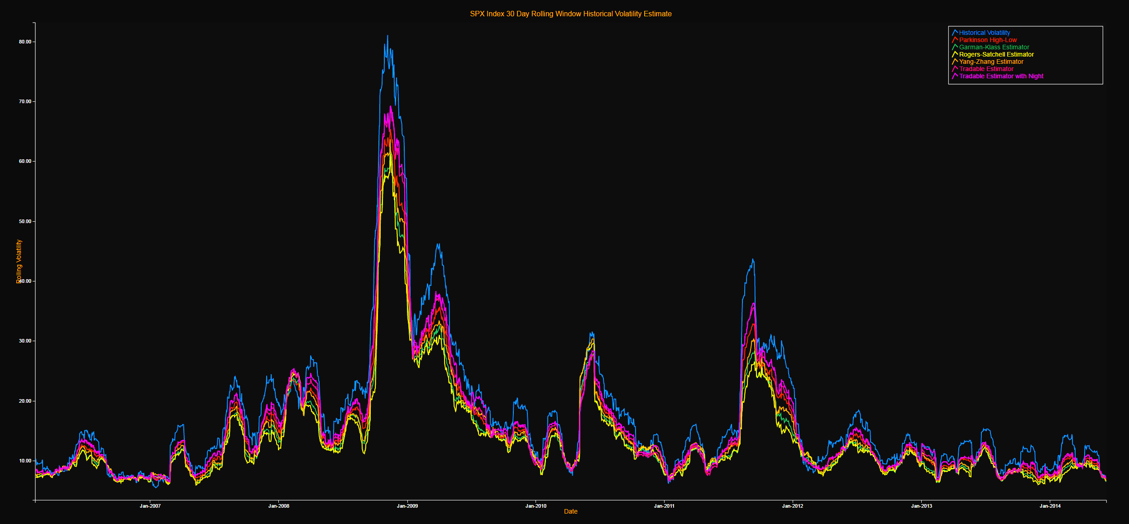
Historical volatility estimation

Slide 41
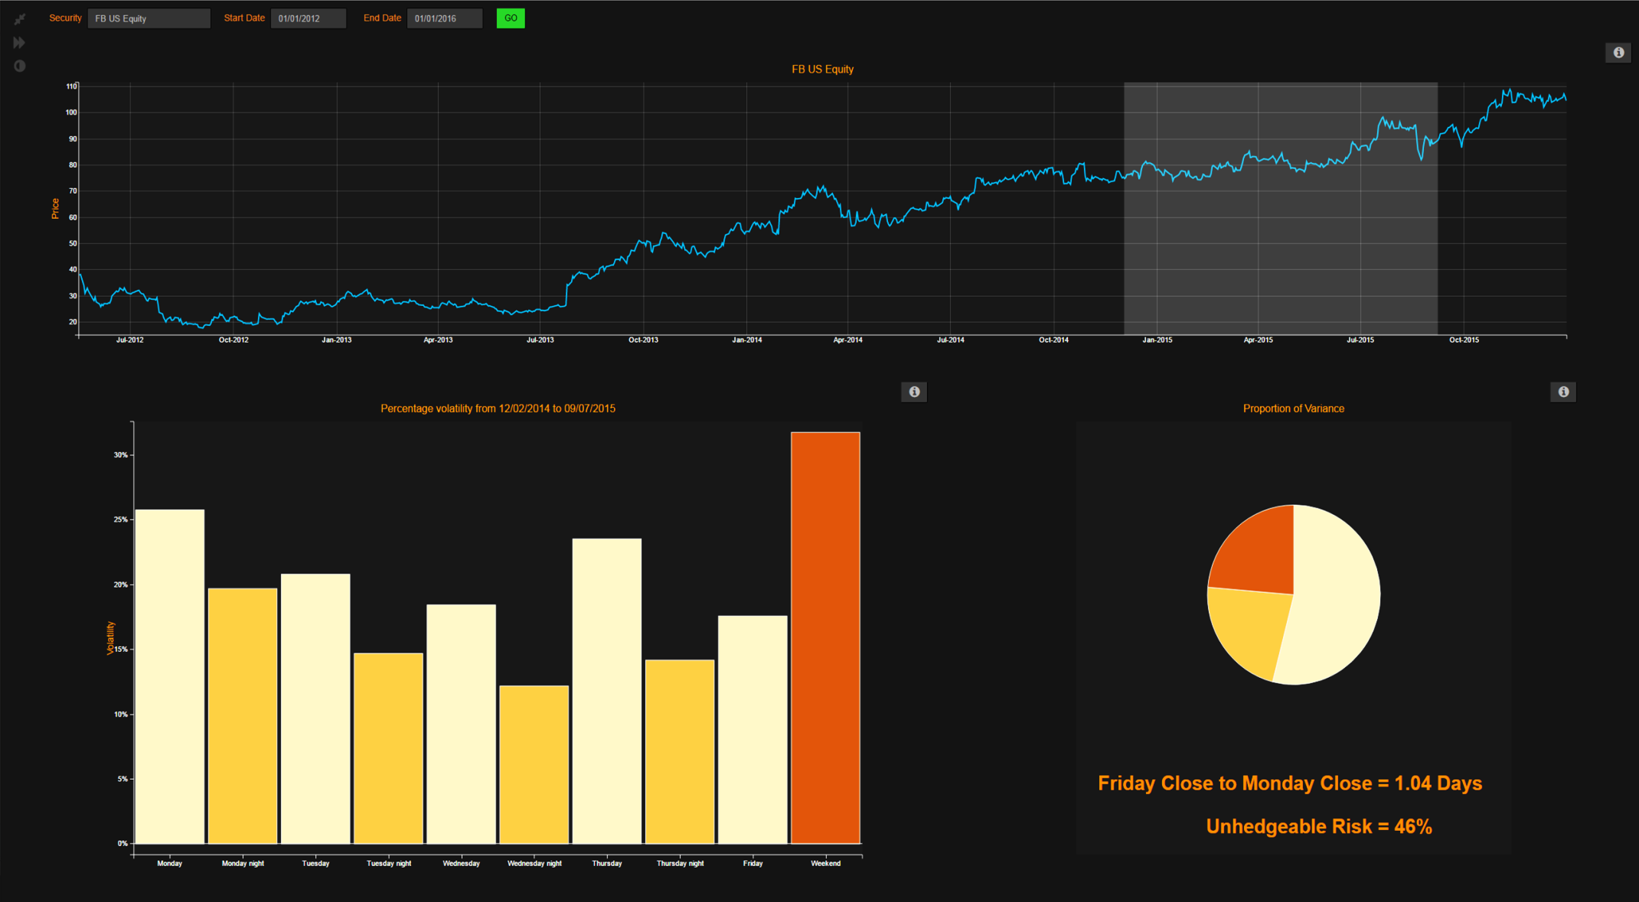
The uncertainty of the night

Slide 42
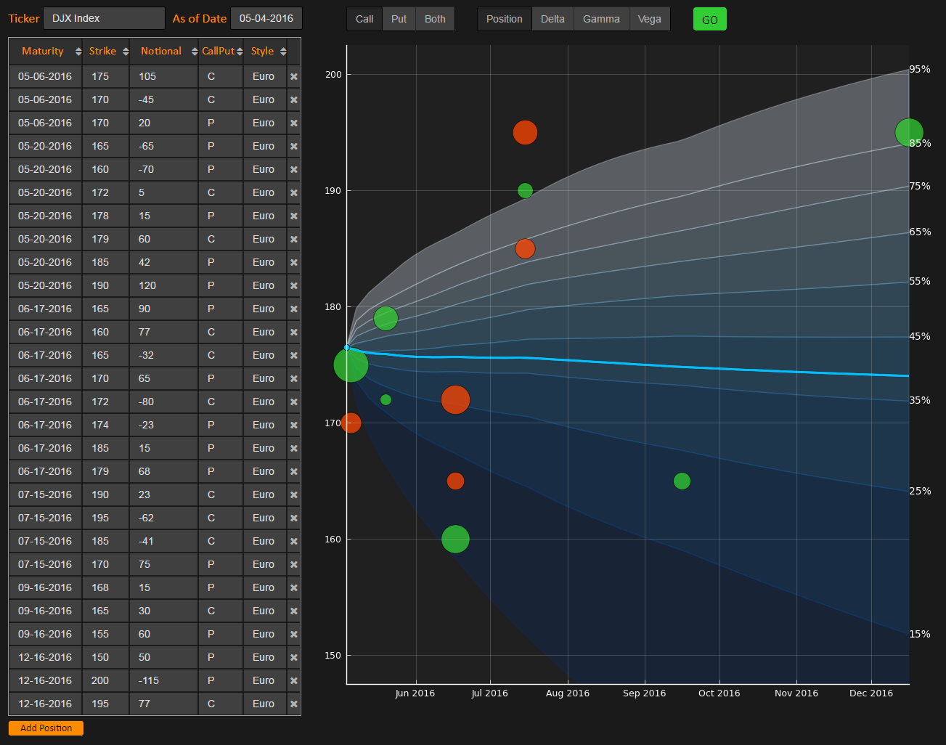
Option Portfolio

Slide 43
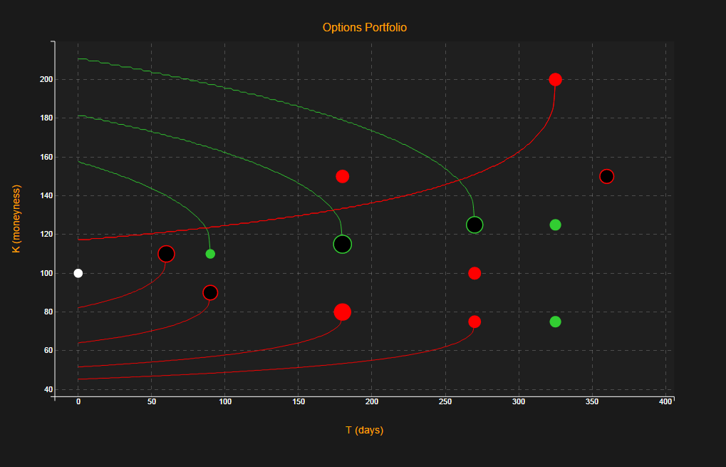
American exercise frontiers

Slide 44
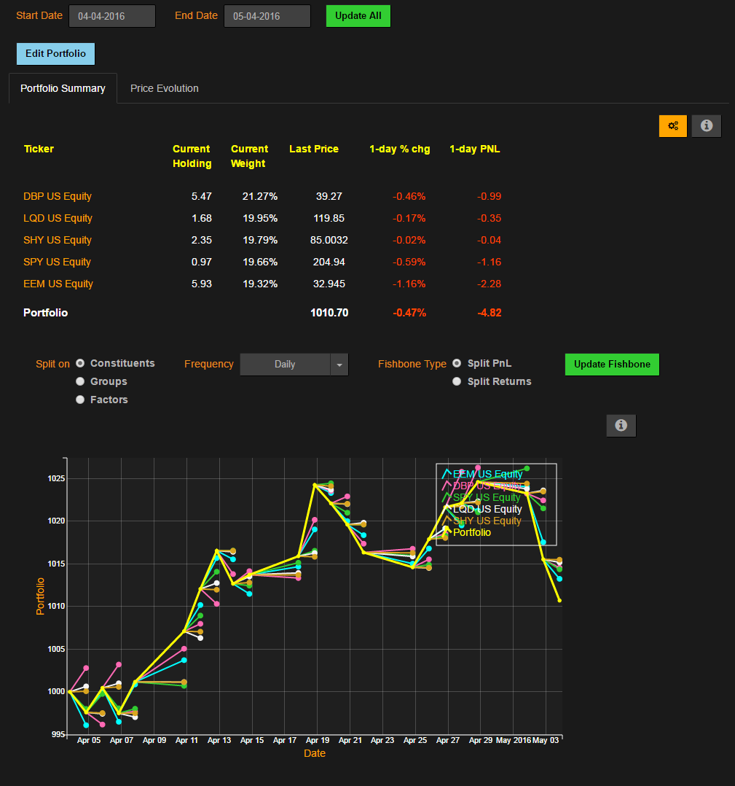
Performance attribution

Slide 45
Volatility risk management
Decomposition of the Vega of an Asian option by strikes and maturities

Slide 46
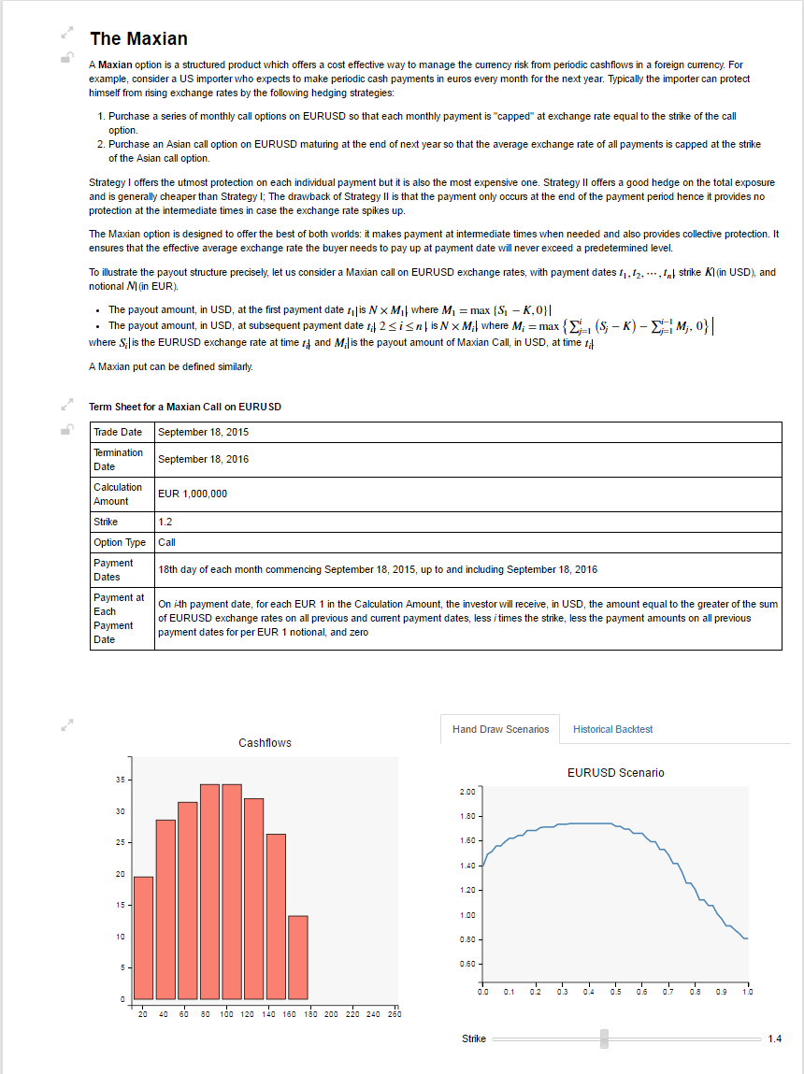
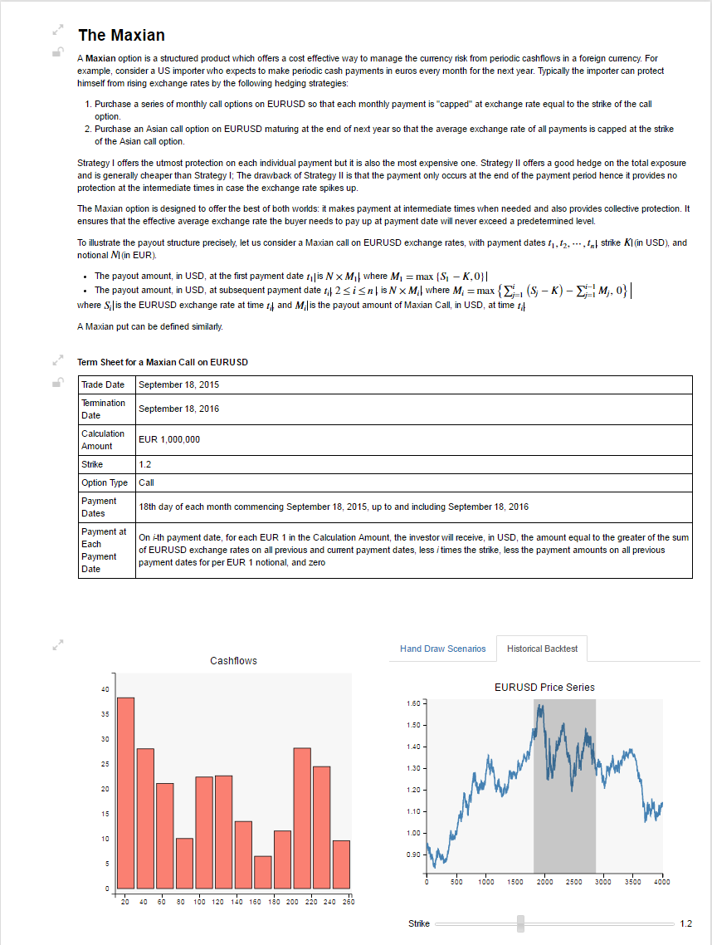
Interactive document

Slide 47
Missing data

Slide 48
CAPM volatility

Slide 49
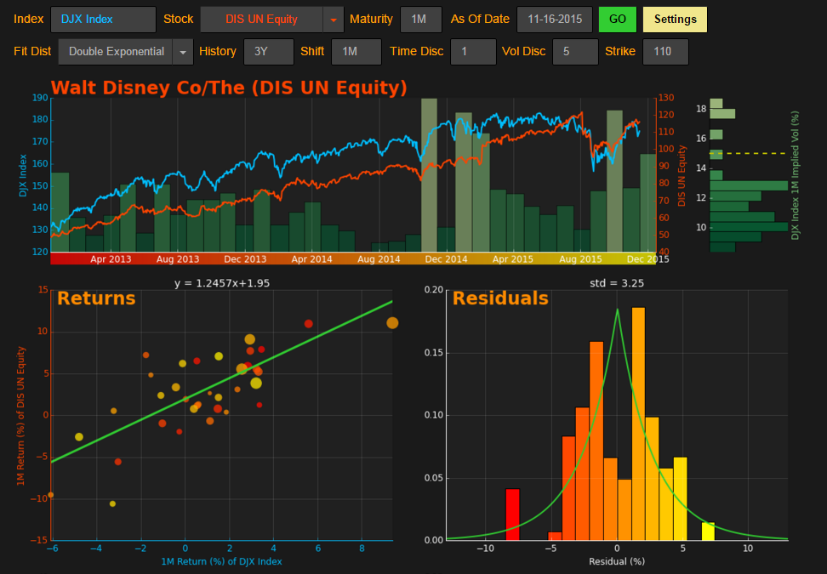
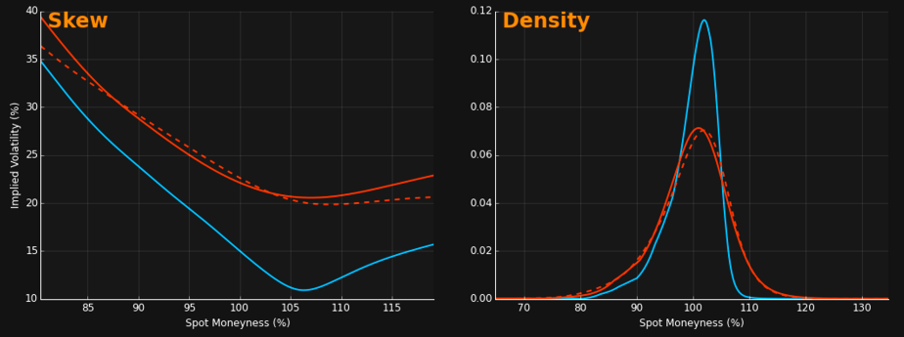
Borrowing the skew
Decomposition equity risk of systematic (market) risk and idiosyncratic risk
$r_{X}=βr_{M}+ε, E\left(ε\right)=0, Cov\left(r_{M}, ε\right)=0$ (CAPM)
$$\left(\frac{X−X_{0}}{X_{0}}−r_{F}\right)=β\left(\frac{I−I_{0}}{I_{0}}−r_{F}\right)+ε$$
The probability distribution of the index I can be extracted from the option prices of the index I
The probability density function (PDF) of the stock X is the convolution of the (scaled) PDF of I and PDF of $ε$
Only need to estimate $β$ and $ε$

Slide 50
Break-even volatility

Slide 51
BEV2 – Gamma Weighted Average
P&L from the continuously delta hedged option is given by where $σt$ is the instantaneous realized volatility at time t
So we need to solve for $σ$* in the below equation –
$Γi$ in the above equation is a function of σ (hence need to solve it iteratively)

Slide 52
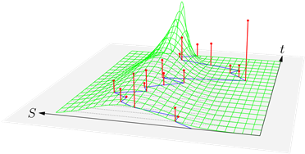
Break Even vol visualization
BEV for one strike is linked to
the quadratic average of the returns (vertical peaks)
weighted by the gamma of the option (surface with the grid) corresponding to that strike.
Notes:
For another strike, the gamma weighting surface will be shifted producing another average and another Break-Even vol
Gammas corresponding to a lower strike
will be shifted to the right of the graph
will weight more the large return
hence give a higher estimate for the associated Break-Even vol

Slide 53
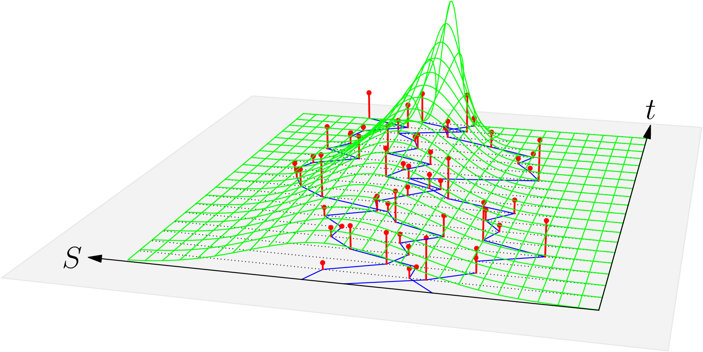
Break Even vol visualization
We can perform the same operation on a set of windows to get a more complete and accurate picture
Notes:
For another strike, the gamma weighting surface will be shifted producing another average and another Break-Even vol
Gammas corresponding to a lower strike
will be shifted to the right of the graph
will weight more the large return
hence give a higher estimate for the associated Break-Even vol

Slide 54
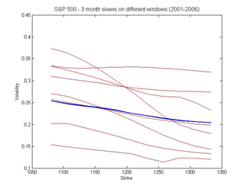
BEV-Time Window Aggregation
Procedures described for a single time window(S_{i} to S_{i+D} where D is time to maturity in days)
For different time series windows we may get substantially different results

Slide 55
elections

Slide 56
brexit

Slide 57
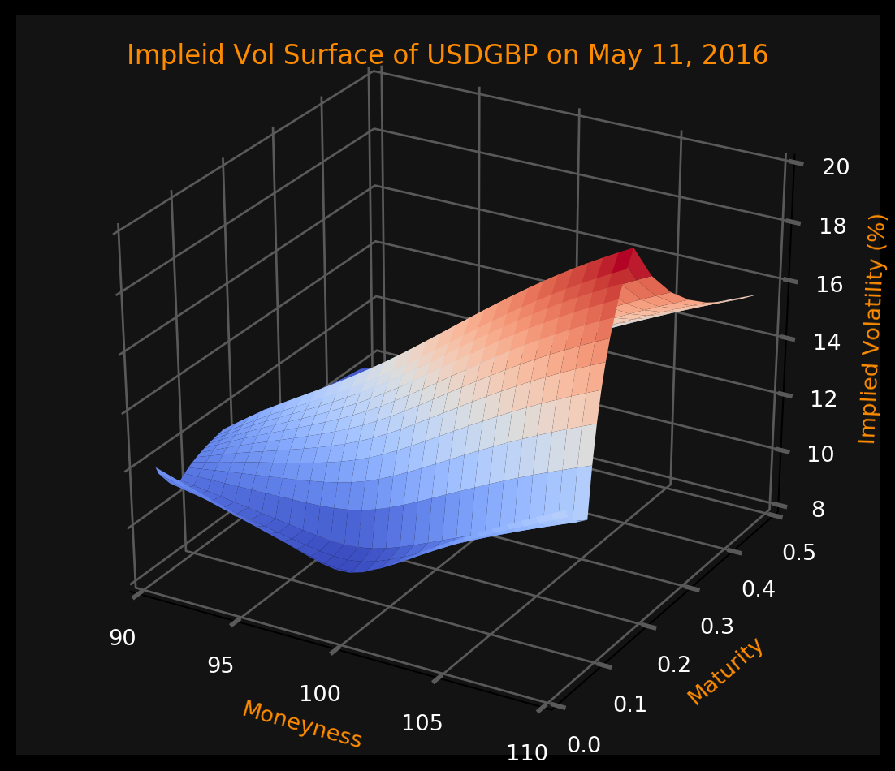
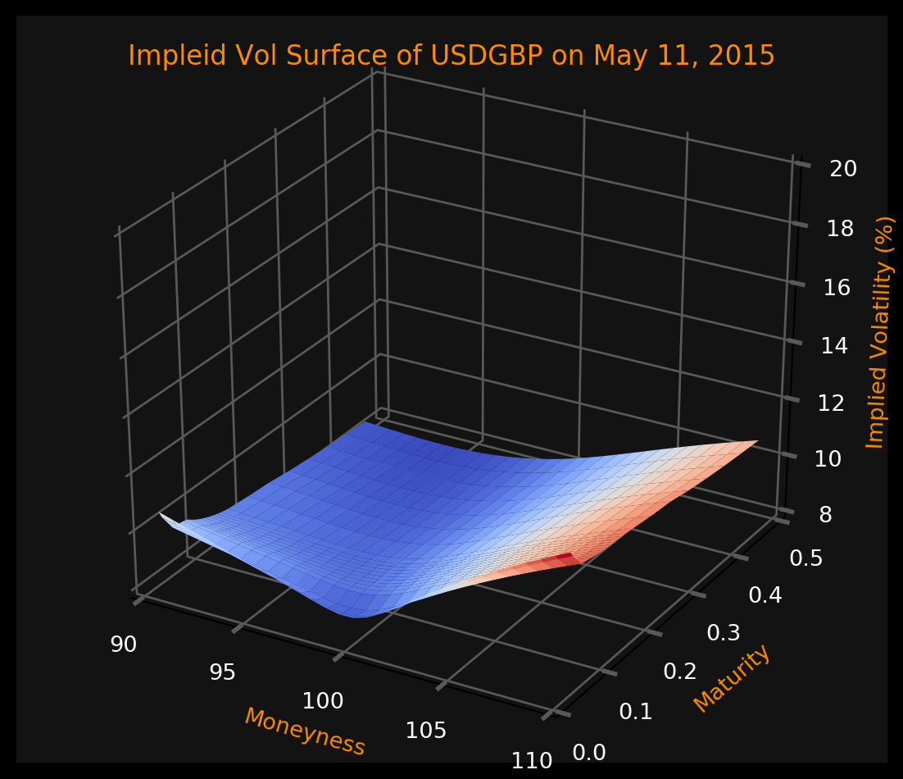
Currency option markets
The currency option markets have seen dramatic changes in the past few months due to the UK’s EU referendum
As a complement to what the polls say, we can listen to the currency option market to understand what market participants are thinking.

Slide 58
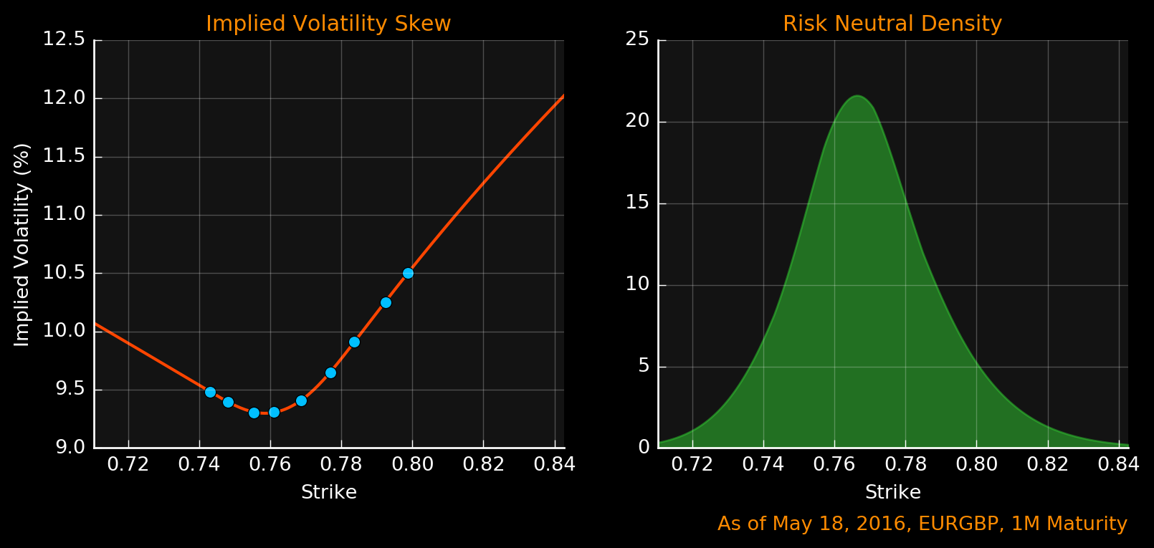
Risk neutral density
Risk neutral probabilities are probabilities of future values of the underlying asset in the “risk-neutral measure”
Risk neutral probabilities can be extracted from the market prices of options

Slide 59
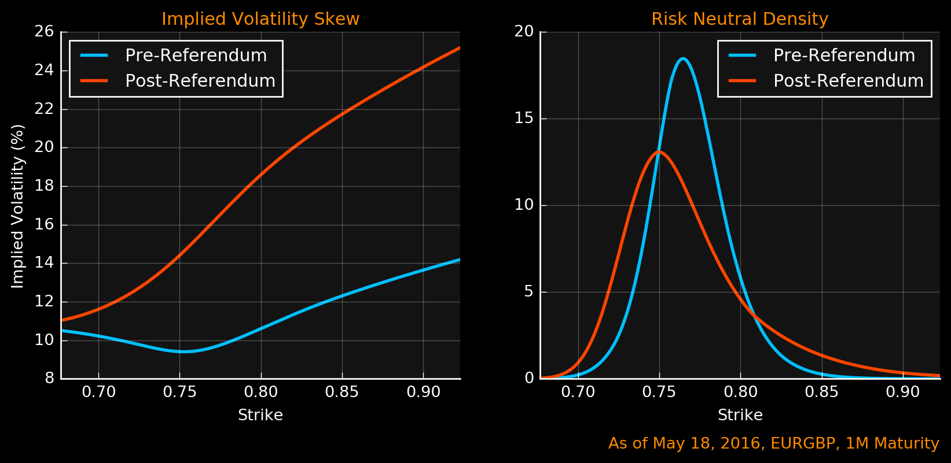
Pre and post referendum
Dramatic change of implied skew before and after the referendum
What is expected to happen on June 23, 2016?

Slide 60
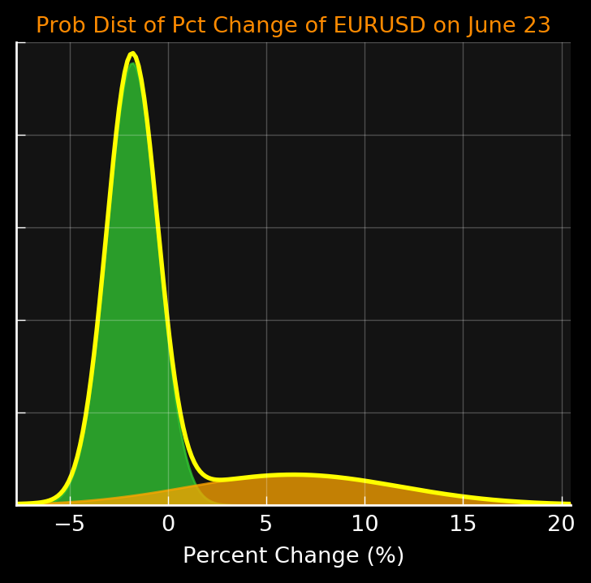
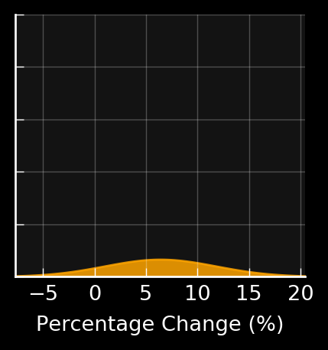
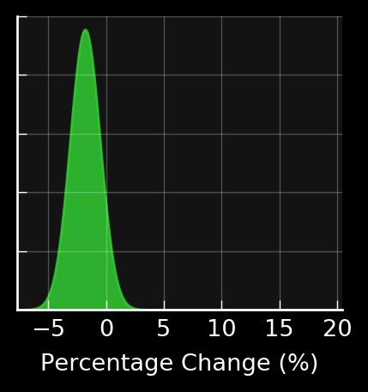
Binary outcome
Brexit
EURGBP expected to increase
More volatile
Binary Outcome
Bremain
EURGBP expected to drop
Less volatile

Slide 61
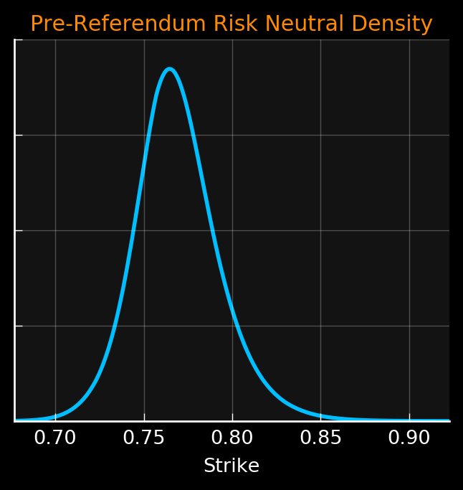
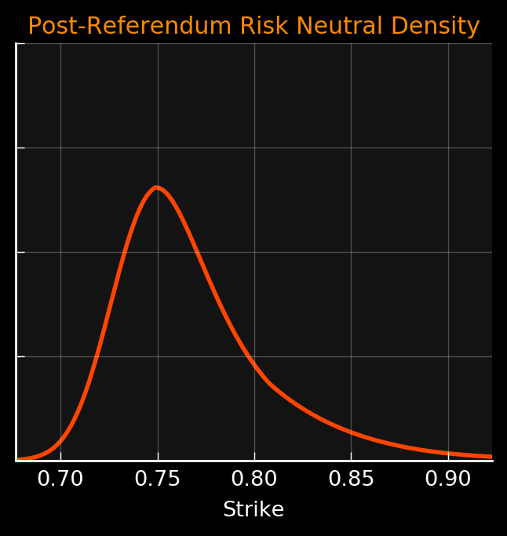
Calibration
The parameters of the bimodal Gaussian distribution are calibrated to be consistent with the market observations of pre- and post-referendum densities
The probabilities of Brexit/Bremain, the expected changes of the exchange rates upon Brexit/Bremain are derived in a consistent manner
+
=

Slide 62
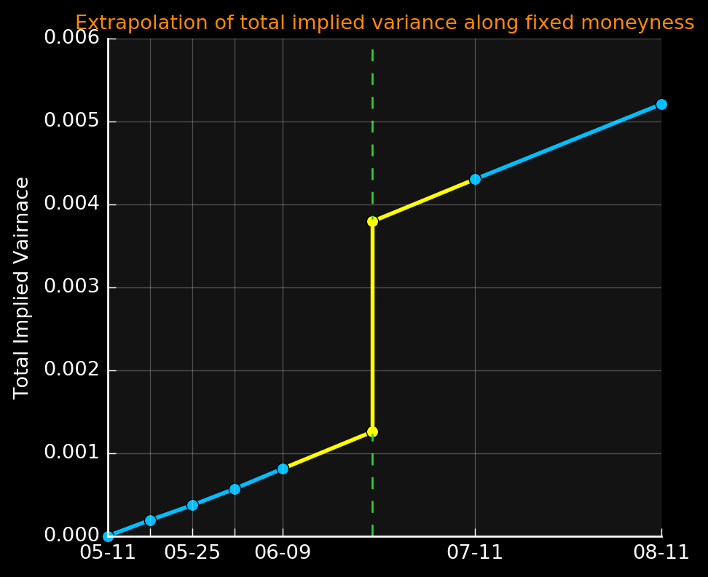
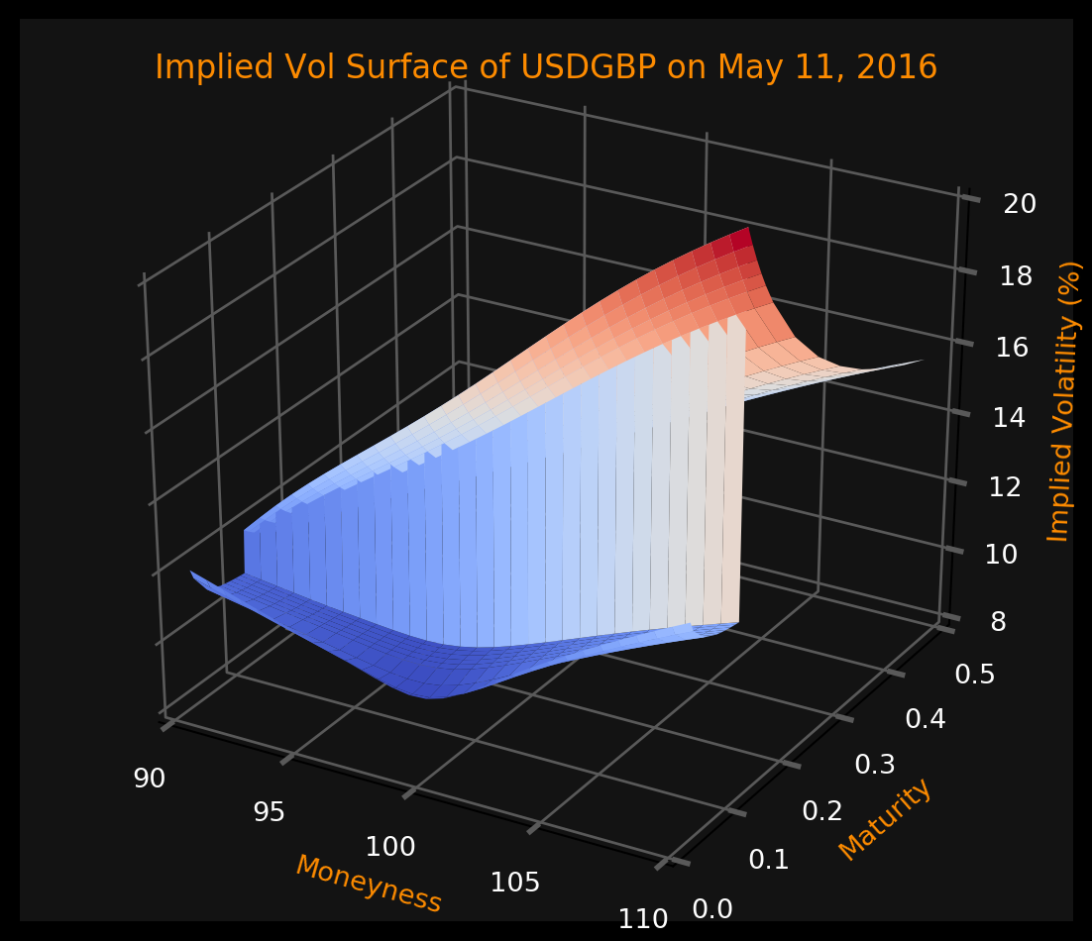
extrapolation
Plain vanilla options are usually quoted for standard tenors, 1W, 2W, 1M, …
Extrapolate from nearby market expiries to the referendum date

Slide 63
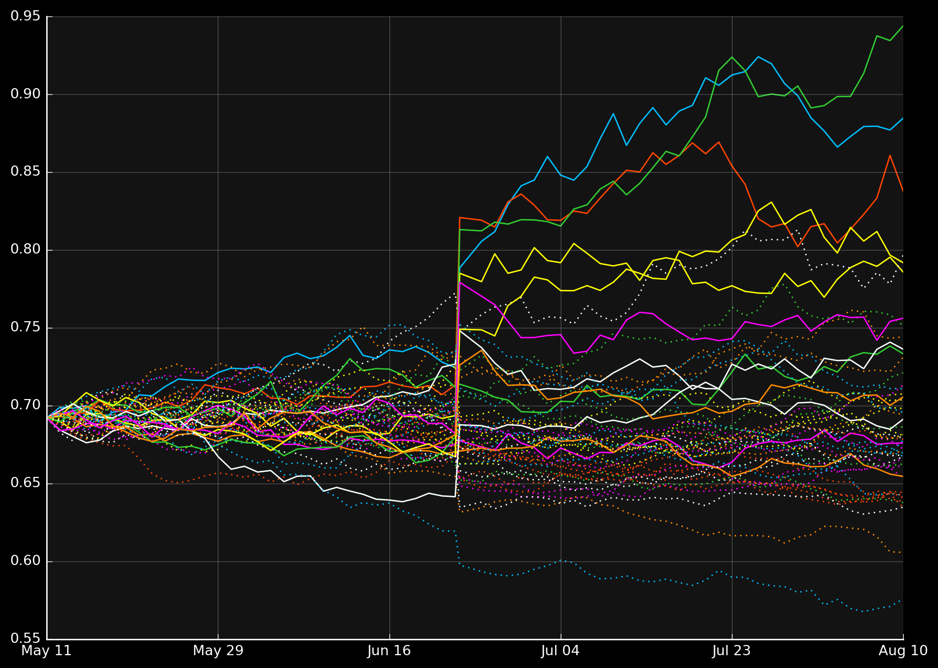
Simulated paths
As of May 11, 2016, Probability of Brexit = 20.2%, Expected Move of USDGBP in case of Brexit = 8.42%
Solid line: Brexit
Dashed line: Bremain
The exchange rate USDGBP follows local volatility dynamics calibrated to the market, except at June 23, 2016, the rate will experience a jump. The jump distribution follows bimodal Gaussian model

Slide 64
US ELECTION

Slide 65
US ELECTION 2016
USDMXN Implied Vol Surface as of Oct 13, 2016

Slide 66
US ELECTION 2016
Excess forward variance observed in the period containing the election day
USDMXN Implied Vol Surface as of Oct 13, 2016

Slide 67
US ELECTION 2016
As of Date: Oct 13, 2016

Slide 68
US ELECTION 2016
As of Date: Oct 13, 2016
58% chance of Clinton victory v.s. 42% Trump victory

Slide 69
FRENCH ELECTION

Slide 70
French Election 2017
Ticker: CAC Index
As of Date: Mar 8, 2017

Slide 71
French Election 2017

Slide 72
French Election 2017
Ticker: CAC Index
As of Date: Mar 8, 2017

Slide 73
French Election 2017
Risk-neutral densities immediately before and after the election (from interpolation)

Slide 74
French Election 2017

Slide 75
French Election 2017

Slide 76
Thank you

